Slide 1
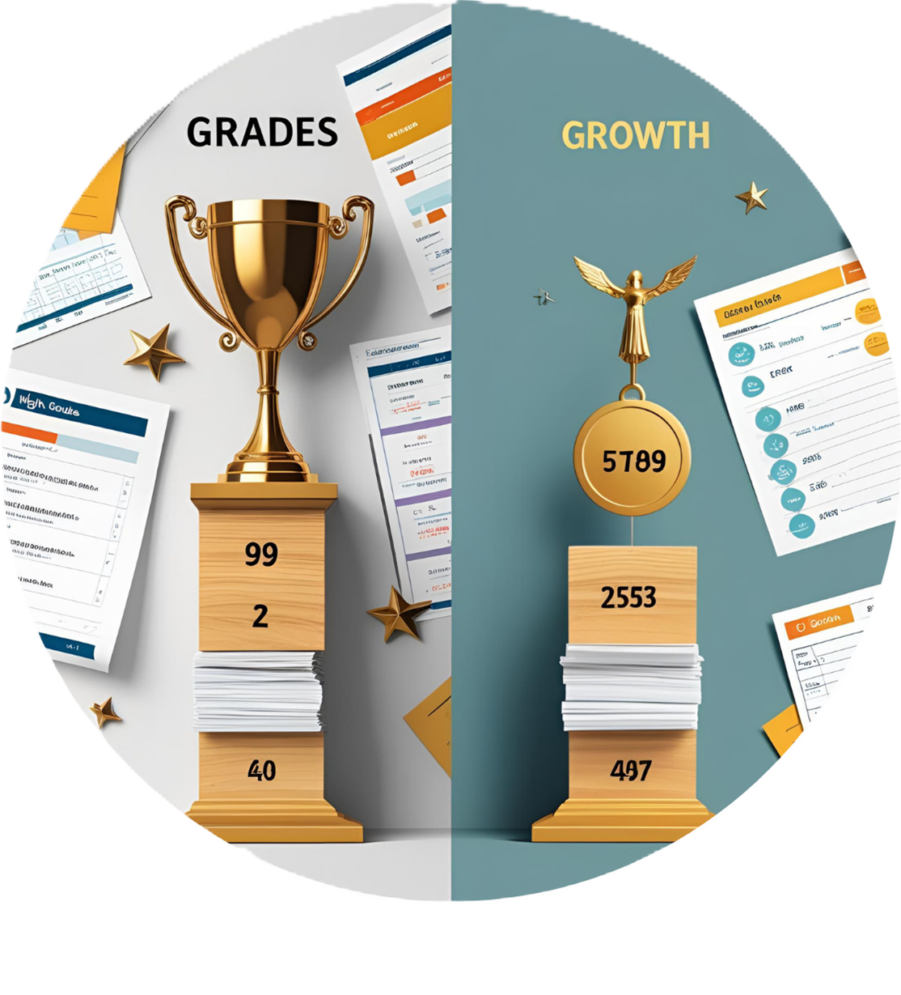
Grades vs. Growth: Rethinking What Success Means for Students and Parents
Insights From
💡 Rasik Rahman A
🔍 Vishal R
🛠 Maishak S
🎤 Ahamed Ahib Ali M.I

Slide 2
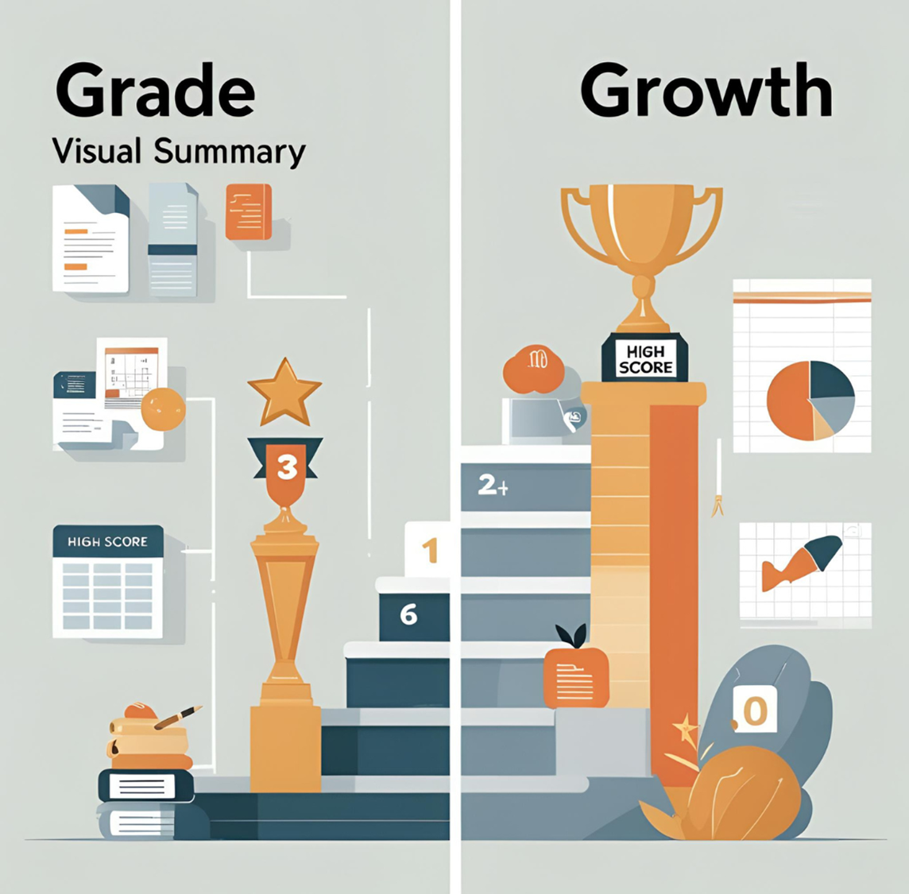
INTRODUCTION
⚫ Do marks really define who you are?
⚫ Grades measure performance, but not your potential or creativity.
⚫ True success comes from growth, resilience, and self-discovery.
Quote
“Everyone is a genius. But if you judge a fish by its ability to climb a tree,it will live its whole life believing it is stupid.“
— Albert Einstein

Slide 3
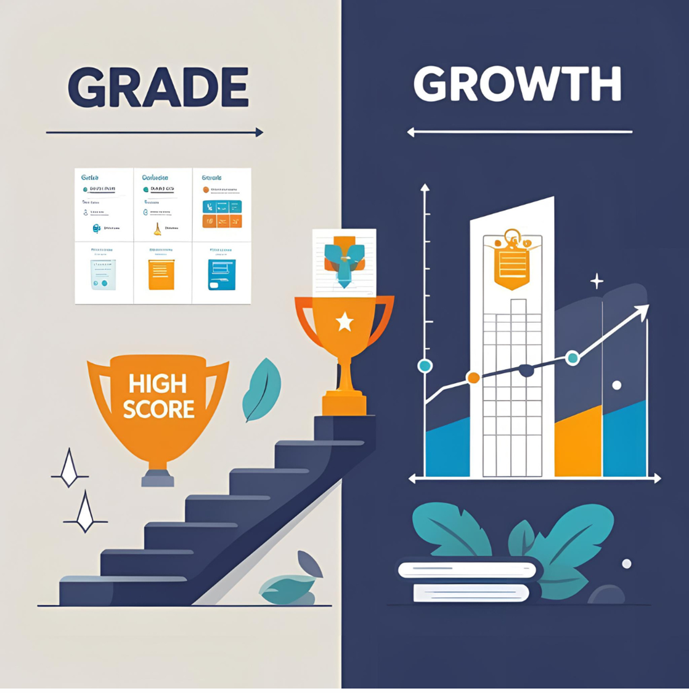
Grades or Growth: What Truly Defines Success?
Grades | Growth
Reflect in academic performance | Focus on learning and personal development
Measure test scores and results | Build skills, resilience, and creativity
Can limit creativity and risk-taking | Continuous and long-term improvement
Success seen as achieving high marks | Encourages curiosity and self-confidence

Slide 4
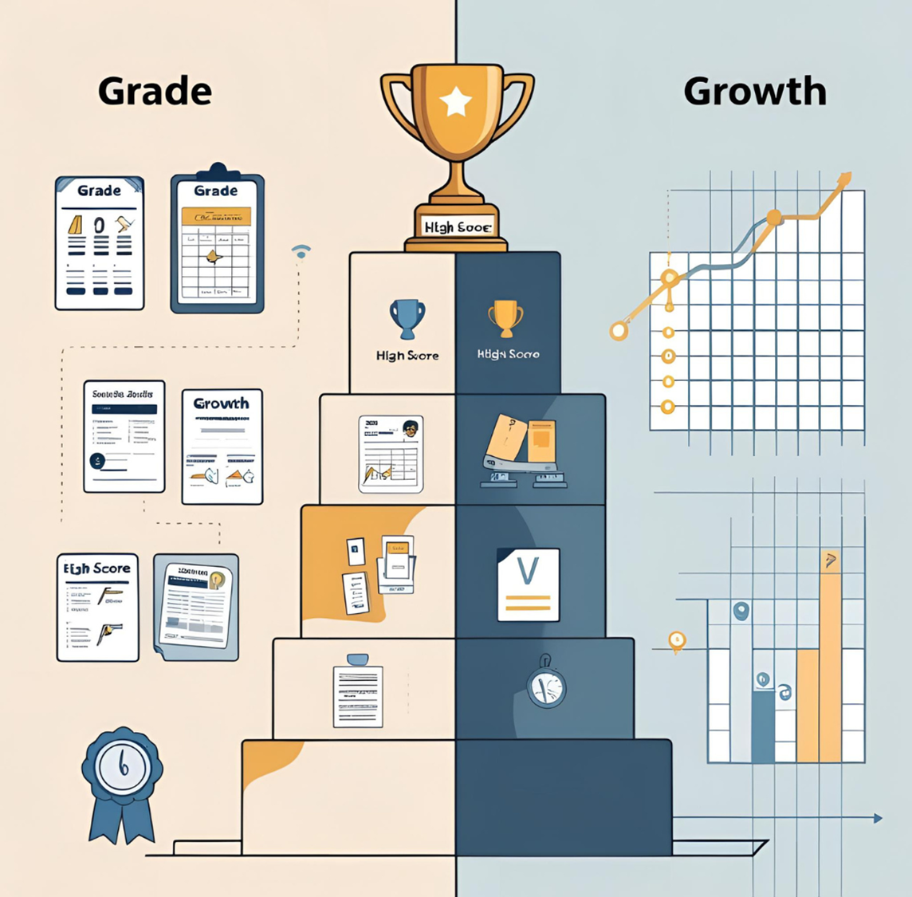
why parents think grades lead to success
⚫ Grades are easy to measure success
⚫ Good grades open doors to jobs and colleges
⚫ High marks improve career chances
⚫ Parents believe grades ensure a secure future.

Slide 5
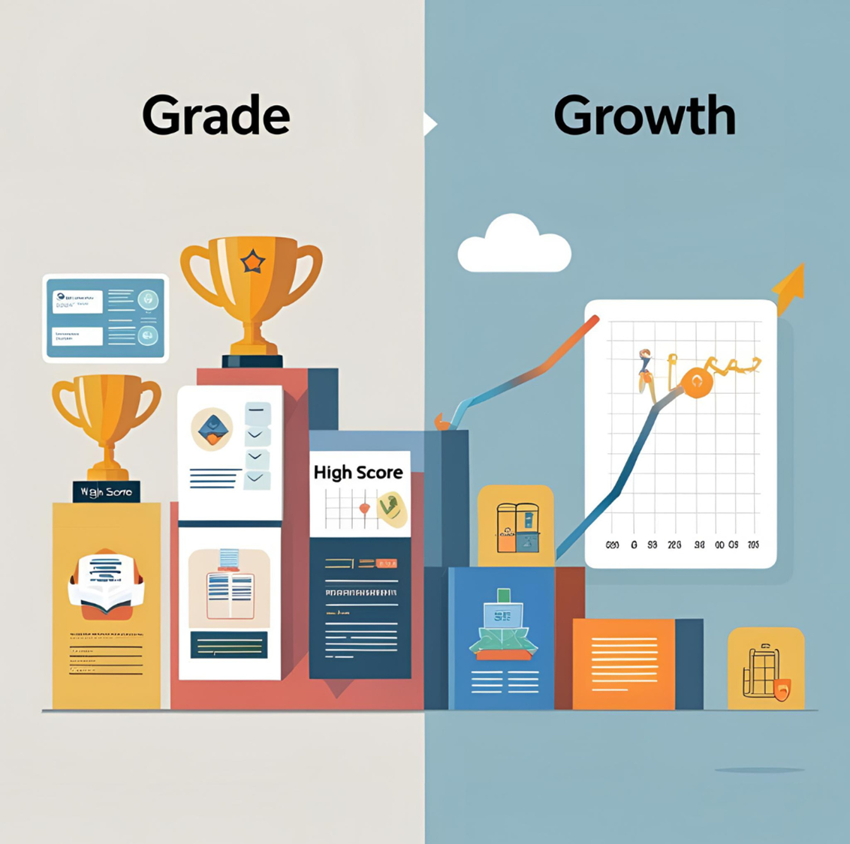
why society still believes in the power of grades
⚫ Grades offer a simple way to compare students.
⚫ High grades are linked to better job and college prospects.
⚫ High grades often represent family pride and social respect.
⚫ Society trusts grades as a sign of hard work and discipline.

Slide 6
What Today’s Students Think About Their Education
⚫ Many students believe that studying well defines them as a “good” or “successful” person.
⚫ Students want their efforts to be recognized beyond just exam scores.
⚫ Education is seen as a way to secure a stable and successful future.
⚫ Students believe good grades bring respect and pride from parents and society.

Slide 7
Students’ Goals vs. Parental Expectations
Students Want | Parents Expect
To follow their passion | To choose a safe and stable job
To explore different paths | To stick to a clear, direct path
To enjoy what they do | To earn a good income and status
To learn from mistakes and grow | To avoid failure and take fewer risks

Slide 8
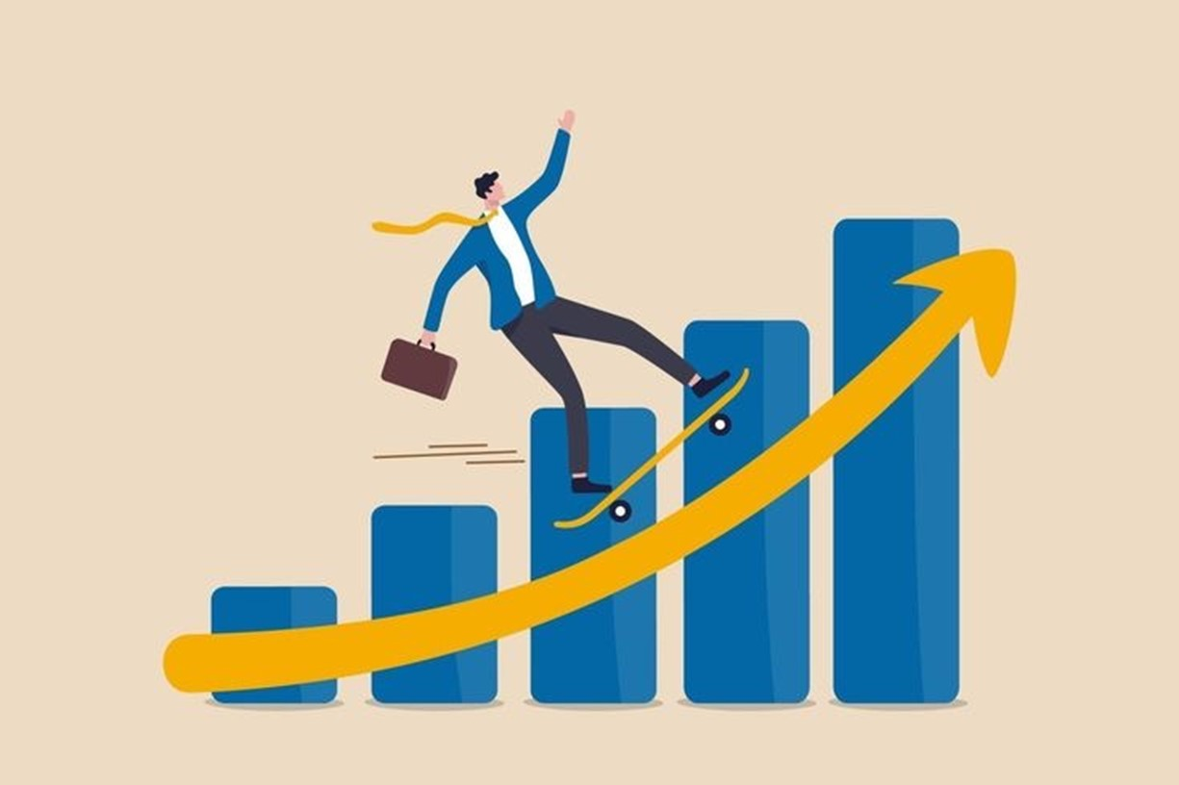
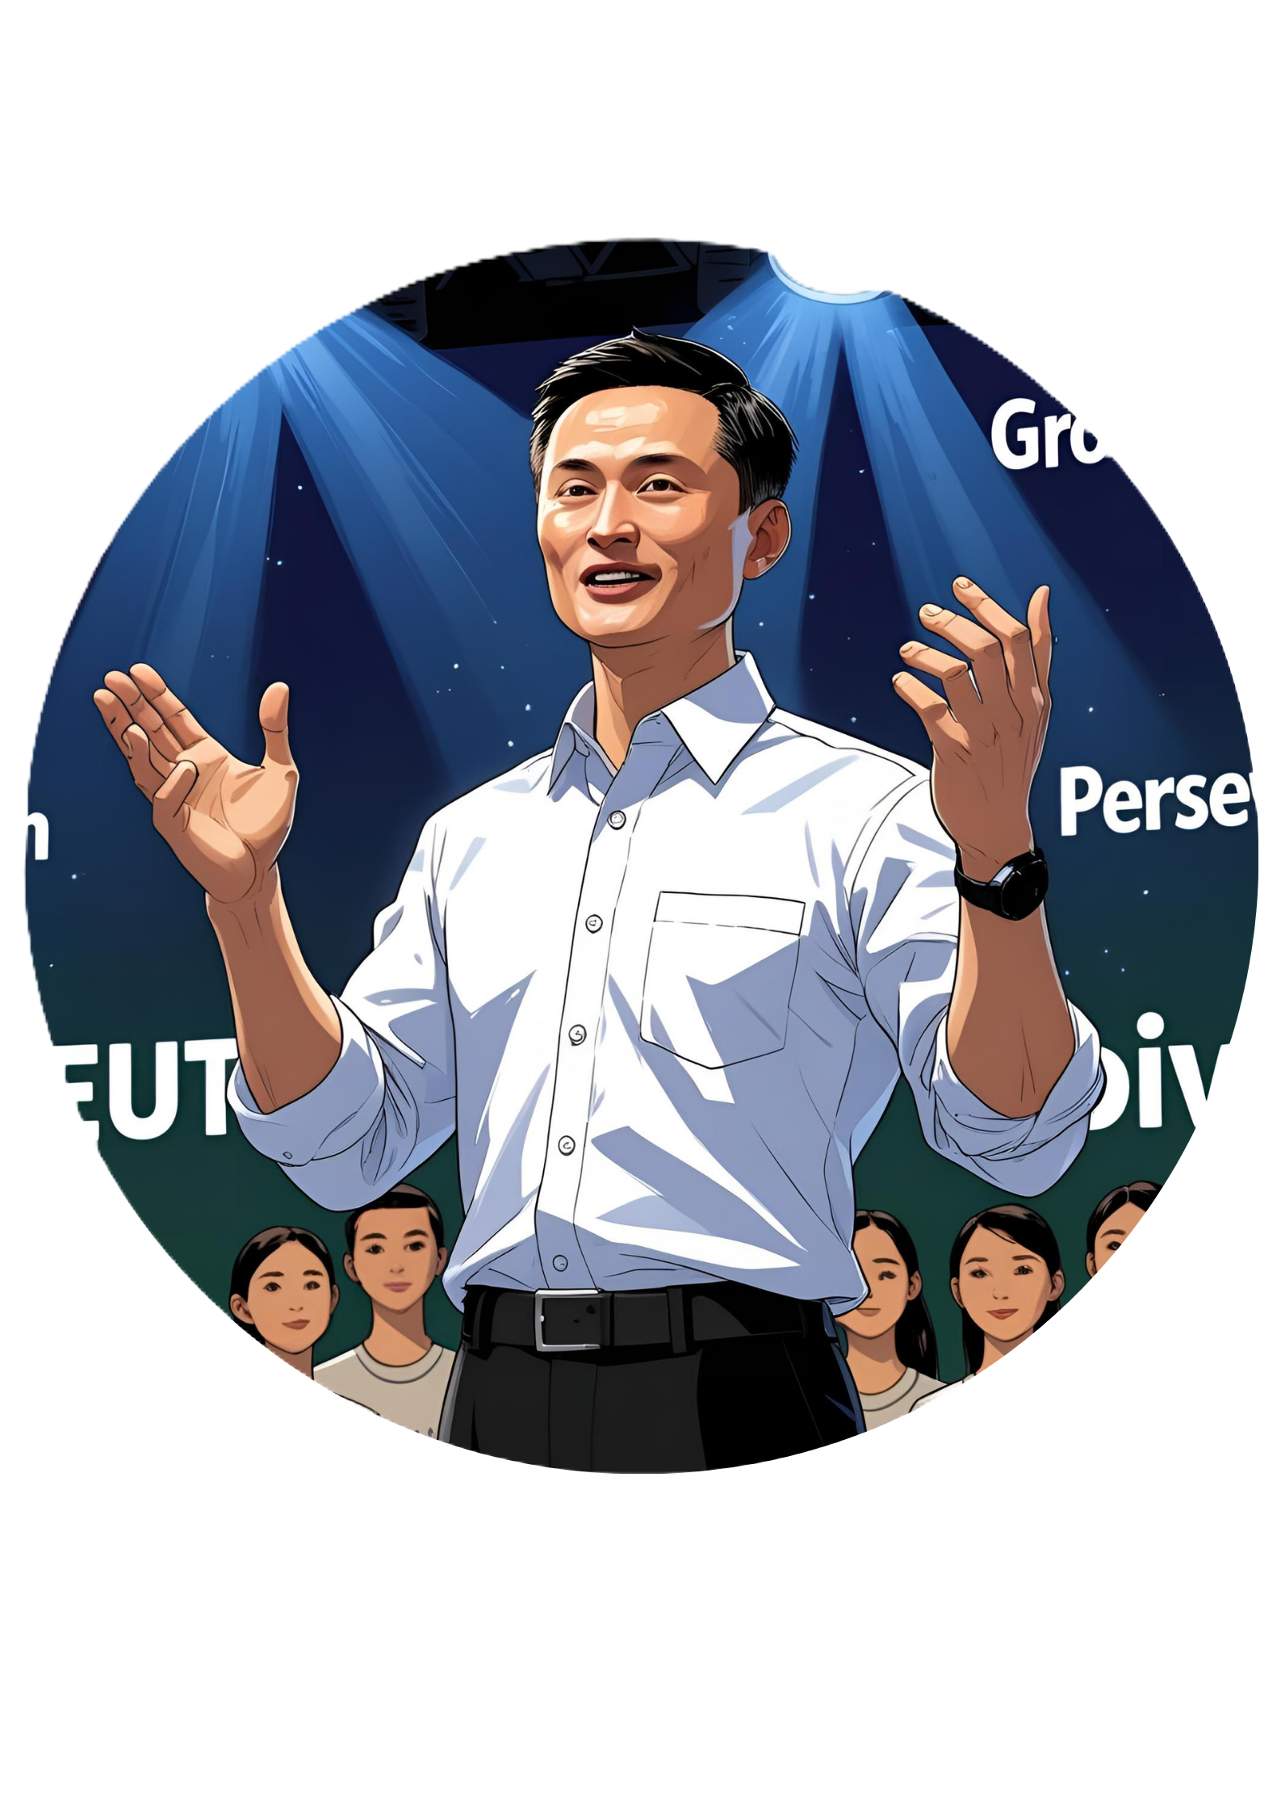
Jack Ma’s Story: Growth Beyond Grades and Failures
⚫ Early Life and Education
⚫ Facing Rejections
⚫ Vision for the Internet
⚫ Achieving Success Through Persistence

Slide 9
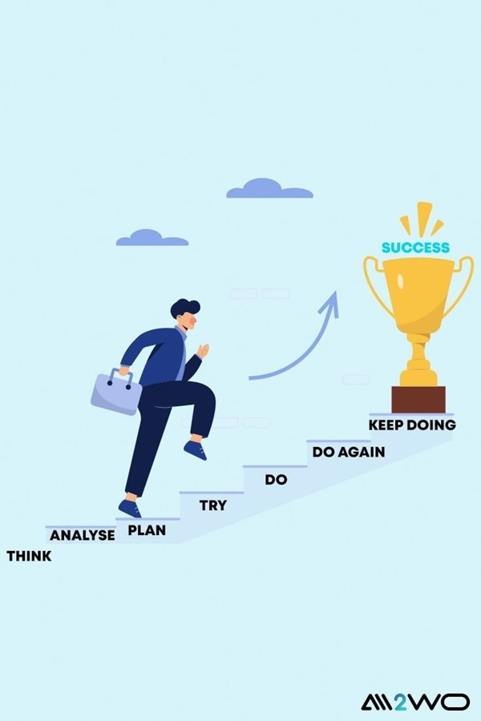
Summary: Learning and Growing Always
⚫ Grades show what you know now — Growth shows what you can become.
⚫ Grades End at School — Growth Lasts a Lifetime
⚫ Growth Makes You Unique — Grades Make You a Number

